Slide 1
Biodiversity knowledge synthesis: an introduction to meta-analyses and systematic reviews How to calculate and combine effect-sizes?
October 2022
Beillouin Damien
Chercheur CIRAD- Hortsys

Slide 2
What is an effect-size?
A metric quantifying the relationship between two entities:
- captures the direction and magnitude of this relationship
- directly extracted from the publication, or calculated
Difference with the p-value?

Slide 3
What is an effect-size?
A metric quantifying the relationship between two entities:
- captures the direction and magnitude of this relationship
- directly extracted from the publication, or calculated
Difference with the p-value?
-It is possible to generate very significant p-values for effect sizes with little practical importance and vice versa
-With enough observations, even tiny differences in parameters become statistically significant

Slide 4
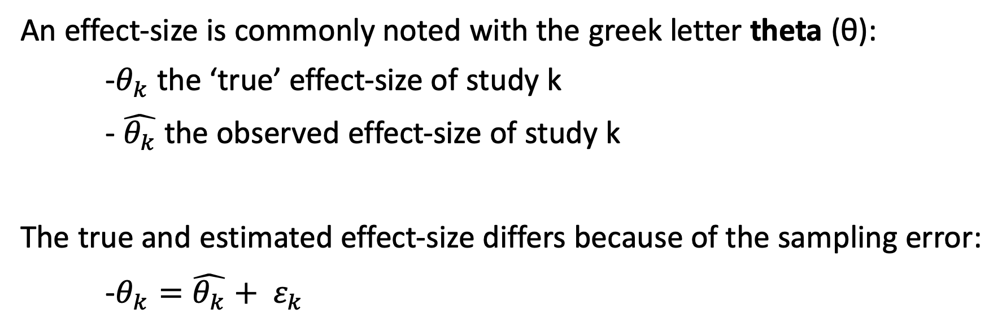
True or estimated effect-size?
An effect-size is commonly noted with the greek letter theta (θ):
-$θ_{k}$ the ‘true’ effect-size of study k
- $\hat{θ_{k}}$ the observed effect-size of study k
The true and estimated effect-size differs because of the sampling error:
-$θ_{k}=\hat{θ_{k}}+ ε_{k}$
Aim of any study: to be as close as possible to the true effect size

Slide 5
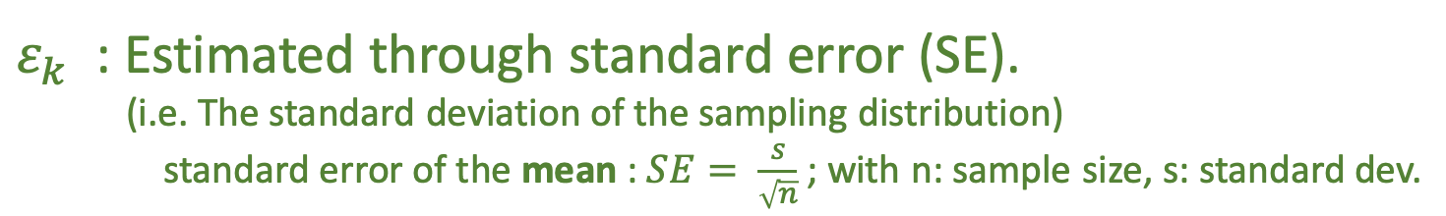
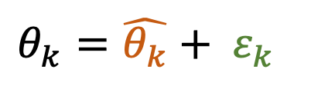
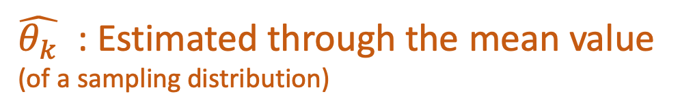
True or estimated effect-size?
Unknown
$θ_{k}=\hat{θ_{k}}+ ε_{k}$
Unknown
$\hat{θ_{k}}$ : Estimated through the mean value
(of a sampling distribution)
$ε_{k}$ : Estimated through standard error (SE).
(i.e. The standard deviation of the sampling distribution)
standard error of the mean : $SE= \frac{s}{\sqrt{n}}$ ; with n: sample size, s: standard dev.

Slide 6
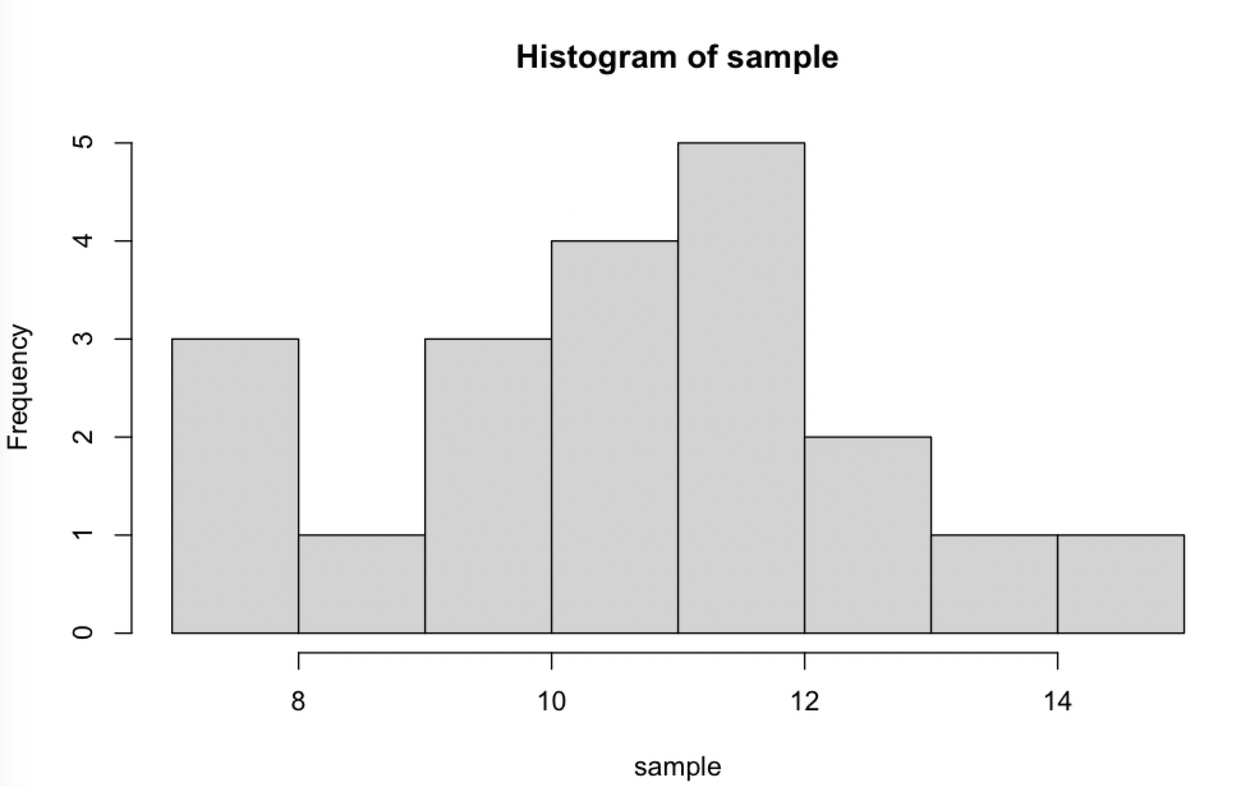
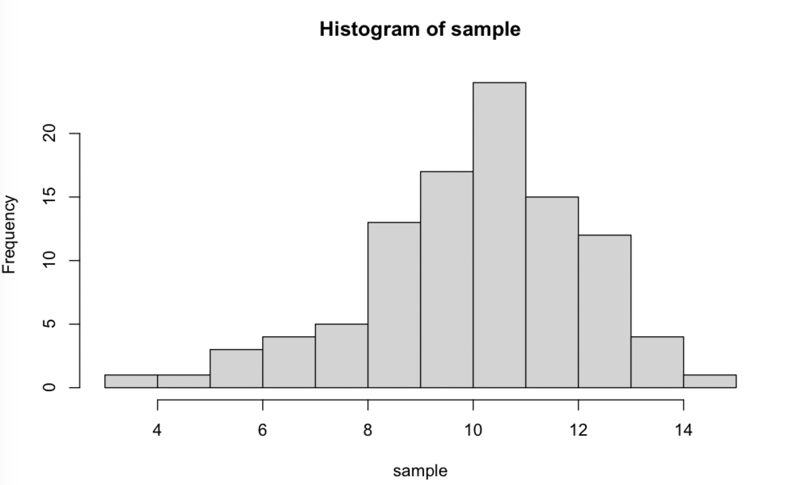
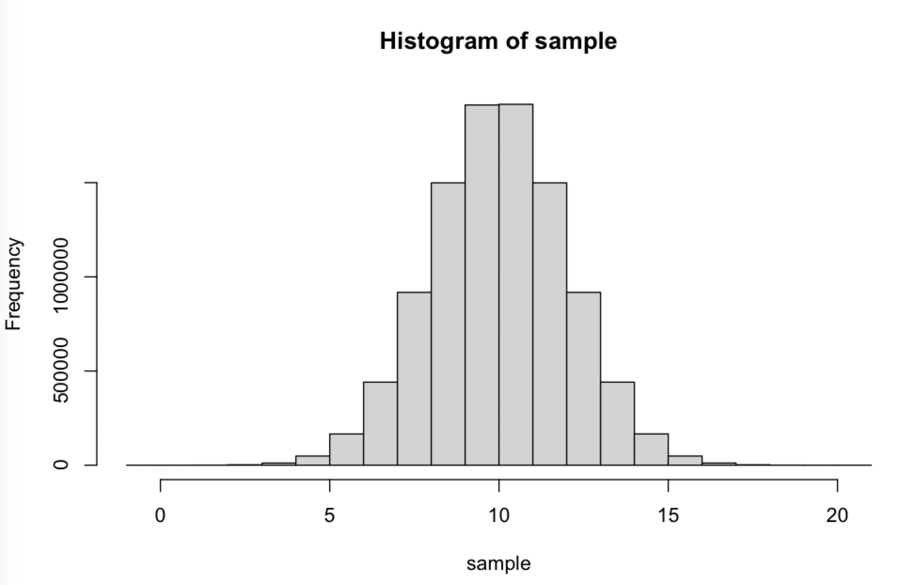
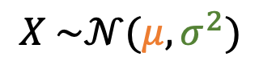
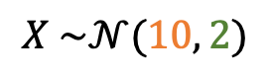
True or estimated effect-size?
$θ_{k}=\hat{θ_{k}}+ ε_{k}$
« The perfect world »
Experiments
A random variable
Mean
Standard dev.
$$X \sim 𝒩(μ,σ^{2})$$
20 exp. units
100 exp. units
Estimated Mean : 10.671
Estimated Mean : 10.063
SE of the mean : 0.436
SE of the mean : 0.199
$$X \sim 𝒩(10, 2)$$

Slide 7
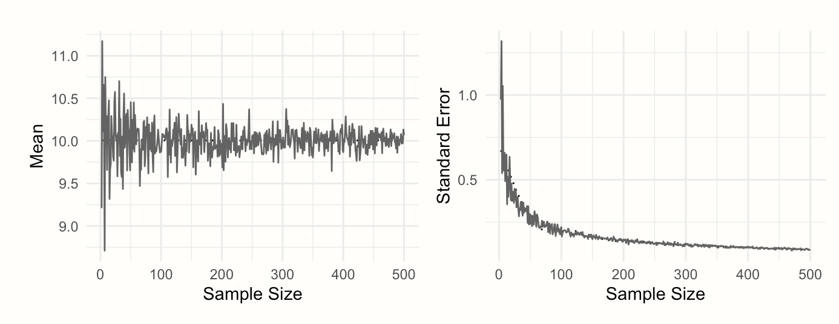
True or estimated effect-size?
$θ_{k}=\hat{θ_{k}}+ ε_{k}$
« The perfect world »
Experiments
A random variable
Mean
Standard dev.
$$X \sim 𝒩(μ,σ^{2})$$
The precision of the estimates increase with sample size
$$X \sim 𝒩(10, 2)$$

Slide 8
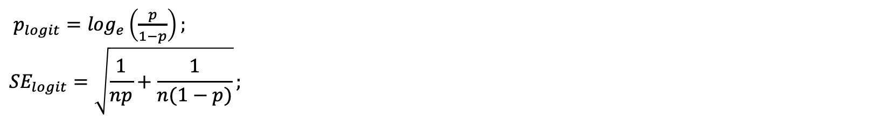
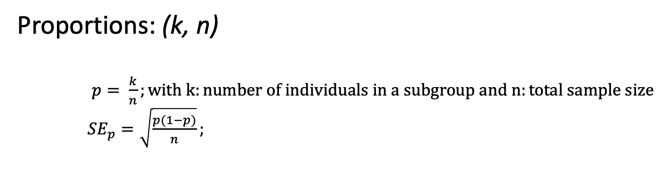
The different type of effect-sizes
Proportions: (k, n)
$p= \frac{k}{n};with k:number of individuals in a subgroup and n:total sample size$
${SE}_{p}=\sqrt{\frac{p(1−p)}{n}};$
To be retrieved:
(k, n)
BUT : 𝑝 ∈ [0,1] → logit transformation (i.e. log (odds ratio)) : 𝐿 ∈ (−∞,∞)
Interpretation
$p_{logit}=\log_{e}\left(\frac{p}{1−p}\right);$
$${SE}_{logit}=\sqrt{\frac{1}{np}+\frac{1}{n(1−p)}};$$
Negative logit : 𝑝 <0.5,
positive logits : 𝑝 <0.5
For ex. used in epidemiological studies

Slide 9
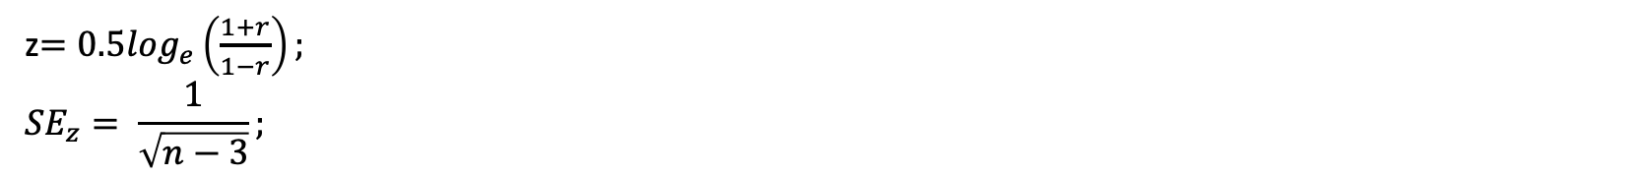
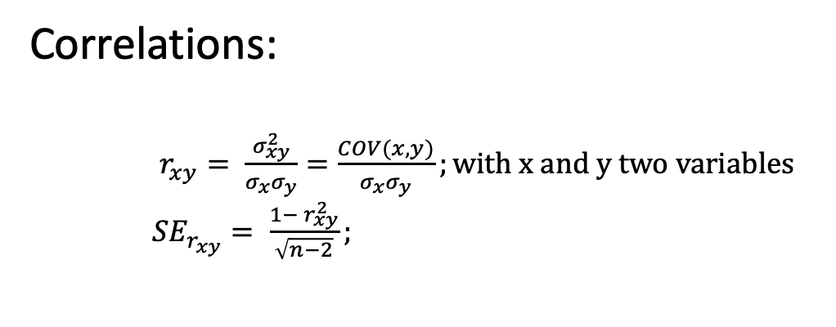
The different type of effect-sizes
Correlations:
$r_{xy}= \frac{σ_{xy}^{2}}{σ_{x}σ_{y}}=\frac{COV(x,y)}{σ_{x}σ_{y}};with x and y two variables$
${SE}_{r_{xy}}= \frac{1− r_{xy}^{2}}{\sqrt{n−2}};$
To be retrieved:
(r, n)
BUT : the range of proportions is restricted between 0 and 1 : problematic -> Fisher’s z
z$={0.5log}_{e}\left(\frac{1+r}{1−r}\right);$
$${SE}_{z}= \frac{1}{\sqrt{n−3}};$$
e.g. Correlation of native and exotic species richness (Peng et al., 2019)

Slide 10
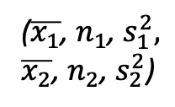
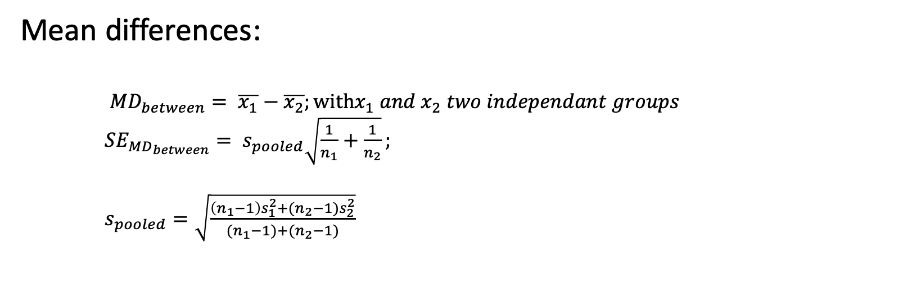
The different type of effect-sizes
Mean differences:
${MD}_{between}= \overline{x_{1}}−\overline{x_{2}};with{x_{1} and x}_{2} two independant groups$
${SE}_{{MD}_{between}}= s_{pooled}\sqrt{\frac{1}{n_{1}}+\frac{1}{n_{2}}};$
$s_{pooled}=\sqrt{\frac{\left(n_{1}−1\right)s_{1}^{2}+(n_{2}−1)s_{2}^{2}}{{(n}_{1}−1)+{(n}_{2}−1)}}$
To be retrieved:
($\overline{x_{1}}$, $n_{1}$, $s_{1}^{2},$
$\overline{x_{2}}$, $n_{2}$, $s_{2}^{2}$)
e.g. Cocoa agroforestry systems versus monocultures (Neither et al., 2020)

Slide 11
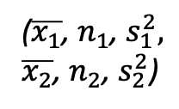
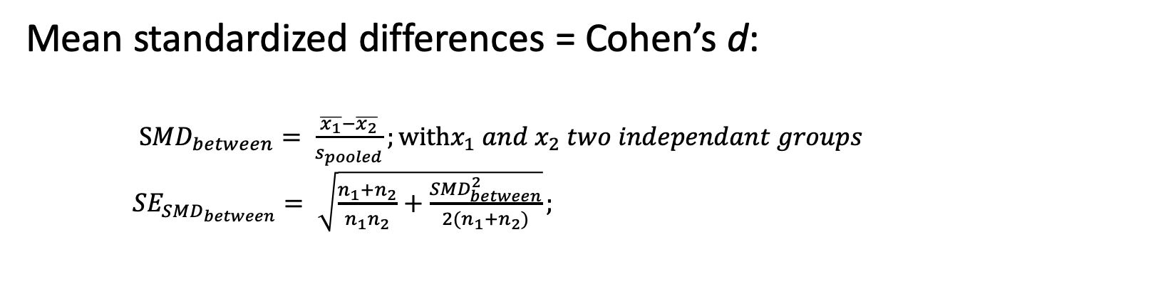
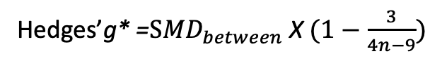
The different type of effect-sizes
Mean standardized differences = Cohen’s d:
$S{MD}_{between}= \frac{\overline{x_{1}}−\overline{x_{2}}}{s_{pooled}};with{x_{1} and x}_{2} two independant groups$
${SE}_{{SMD}_{between}}= \sqrt{\frac{n_{1}+n_{2}}{n_{1}n_{2}}+\frac{{SMD}_{between}^{2}}{2{(n}_{1}+n_{2})}};$
To be retrieved:
($\overline{x_{1}}$, $n_{1}$, $s_{1}^{2},$
$\overline{x_{2}}$, $n_{2}$, $s_{2}^{2}$)
BUT bias when the sample size of a study is small, especially when n≤ 20 (L. V. Hedges 1981).
Interpretation
Hedges’g* =$S{MD}_{between}$ X $(1−\frac{3}{4n−9})$
SMD= 2 -> a difference
of 2 standard deviations

Slide 12
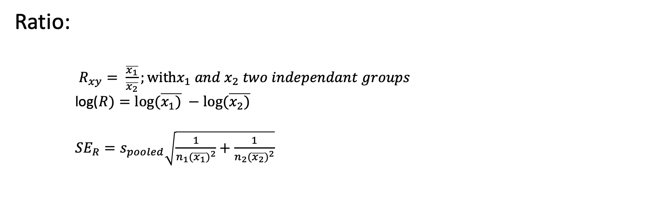
The different type of effect-sizes
Ratio:
$R_{xy}= \frac{\overline{x_{1}}}{\overline{x_{2}}};with{x_{1} and x}_{2} two independant groups$
log($R)=log⁡(\overline{x_{1})} −log⁡(\overline{x_{2})}$
${SE}_{R}=s_{pooled}\sqrt{\frac{1}{n_{1}{(\overline{x_{1}})}^{2}}+\frac{1}{n_{2}{(\overline{x_{2}})}^{2}}}$
To be retrieved:
($\overline{x_{1}}$, $n_{1}$, $s_{1}^{2},$
$\overline{x_{2}}$, $n_{2}$, $s_{2}^{2}$)

Slide 13
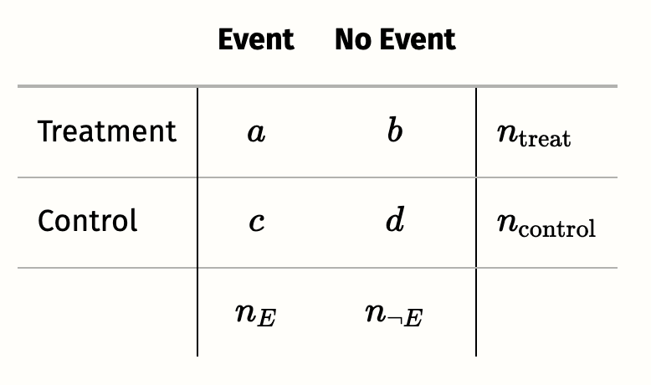
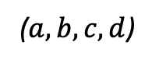
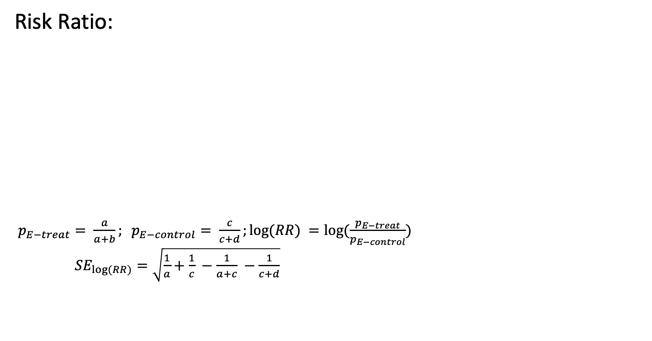
The different type of effect-sizes
Risk Ratio:
$p_{E−treat}= \frac{a}{a+b}; p_{E−control}= \frac{c}{c+d};log⁡(RR) =log⁡(\frac{p_{E−treat}}{p_{E−control}})$
${SE}_{log⁡(RR)}=\sqrt{\frac{1}{a}+\frac{1}{c} −\frac{1}{a+c} −\frac{1}{c+d}}$
To be retrieved:
($a,b,c,d$)

Slide 14
How to pool effect-sizes?
Vote counting :
Should be avoided whenever possible.
-do not account for different weights given to each study
-Do not inform and the magnitude of the effect

Slide 15
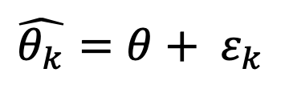
How to pool effect-sizes?
Fixed-effect model:
all effect sizes stem from a single population
-> all studies share the same true effect size
$\hat{θ_{k}}=θ+ ε_{k}$
The true effect size for study k is not only true for k specifically, but for all studies in our meta-analysis

Slide 16
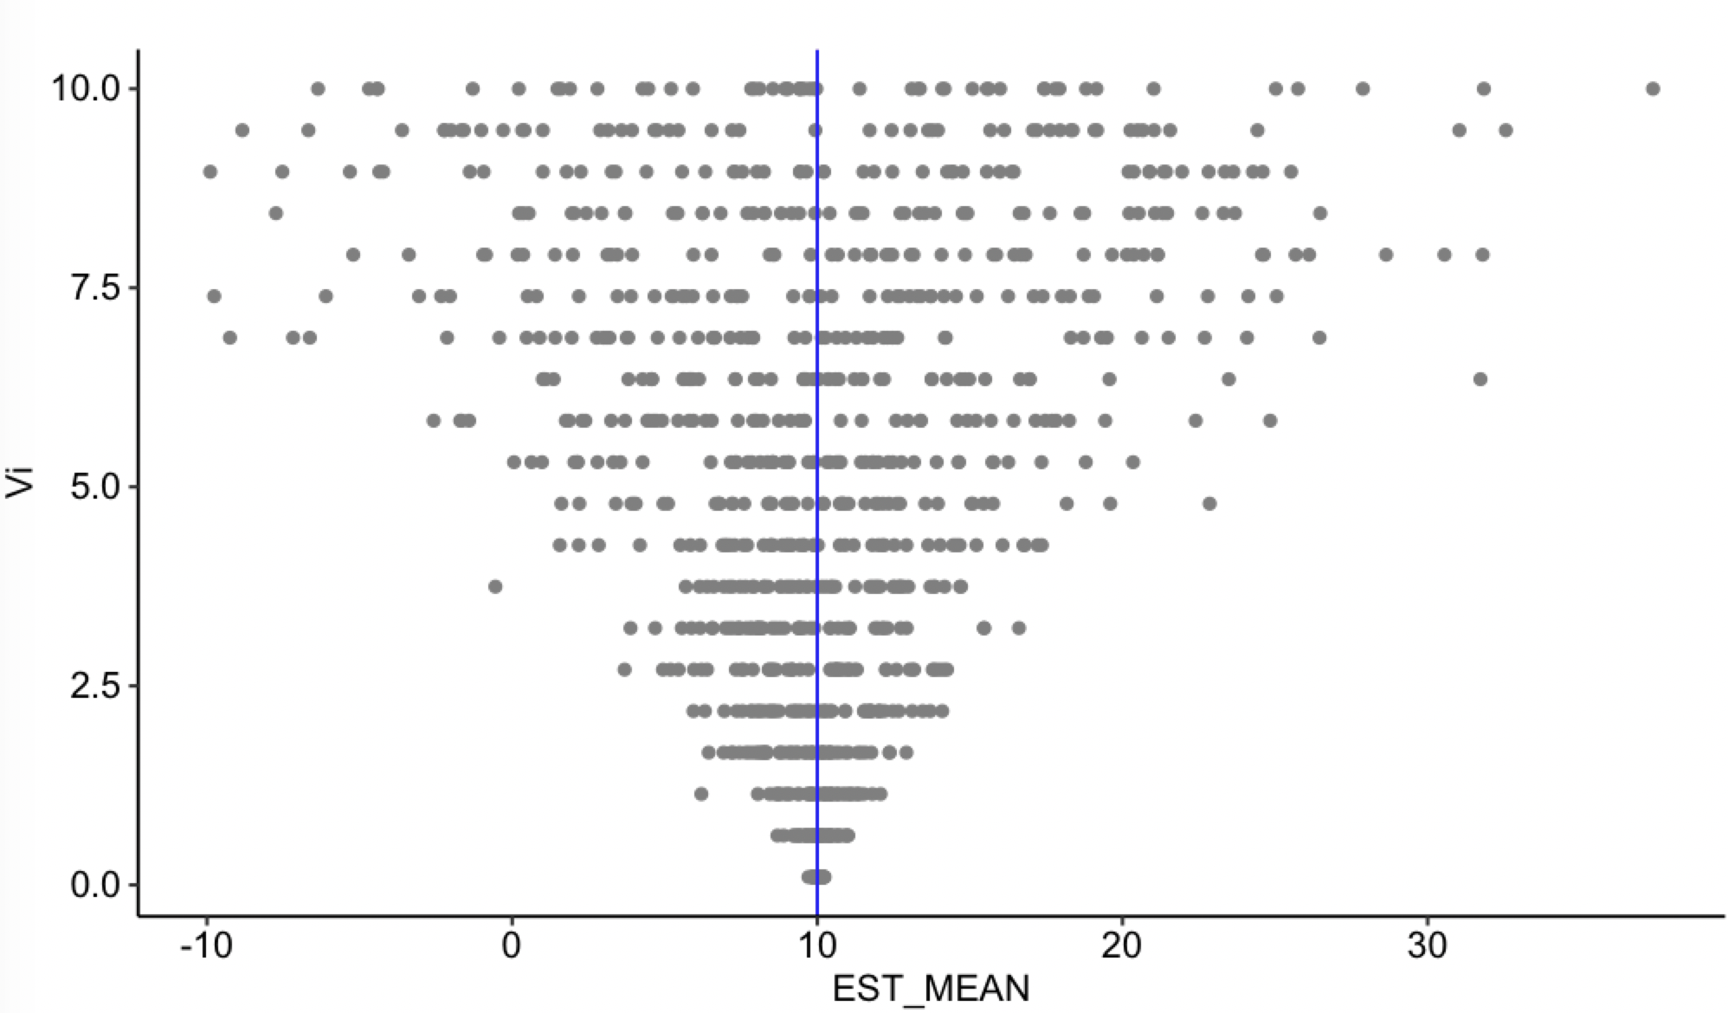
How to pool effect-sizes?
Fixed-effect model:
« The perfect world »
Sampling variance
Effect-size

Slide 17
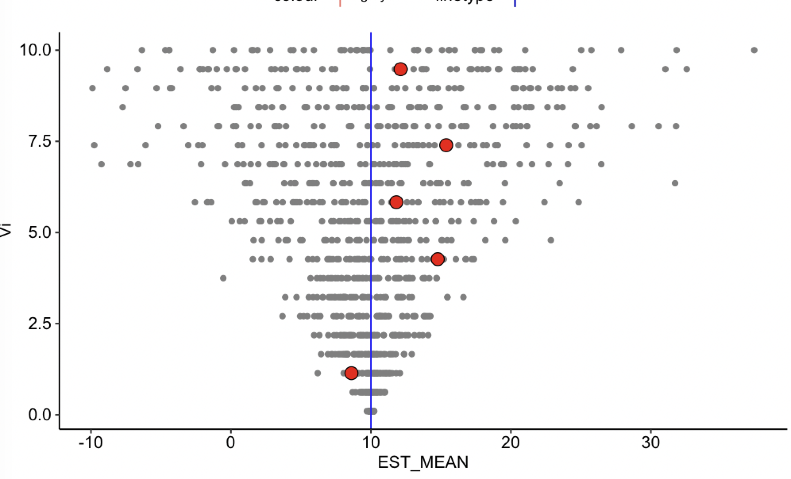
How to pool effect-sizes?
Fixed-effect model:
« The perfect world »
Sampling variance
Effect-size

Slide 18
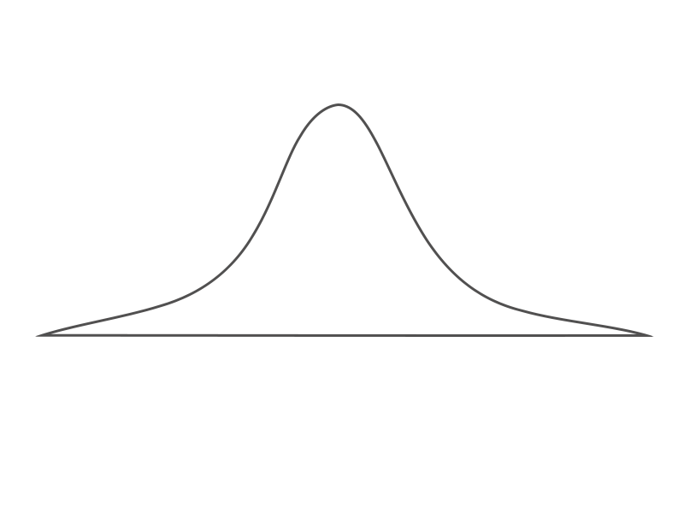
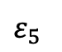
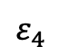
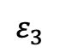
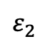
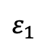
How to pool effect-sizes?
Fixed-effect model:
« The perfect world »
« The experimental world »
$ε_{1}$
$ε_{2}$
$ε_{3}$
Sampling variance
$ε_{4}$
$ε_{5}$
Effect-size

Slide 19
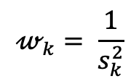
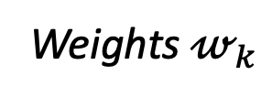
How to pool effect-sizes?
Fixed-effect model:
Weights $𝓌_{k}$
The usual statistical method for combining results of multiple studies is to weight studies by the amount of information they contribute
$$𝓌_{k}= \frac{1}{s_{k}^{2}}$$

Slide 20
How to pool effect-sizes?
Fixed-effect model:
BUT does not account for:
The outcome of interest could have been measured in many ways.
The type of treatment may not have been exactly the same.
The intensity and duration of treatment could differ.
The target population of the studies may not have been exactly the same for each study.
The control groups used may have been different.
→ between-study heterogeneity

Slide 21
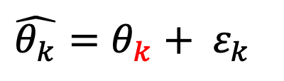
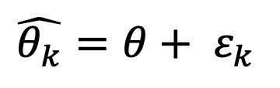
How to pool effect-sizes?
Fixed-effect model:
all effect sizes stem from a single population
-> all studies share the same true effect size
Random-effect model:
There is a distribution of true effect-sizes
$\hat{θ_{k}}=θ+ ε_{k}$
$\hat{θ_{k}}=θ_{k}+ ε_{k}$

Slide 22
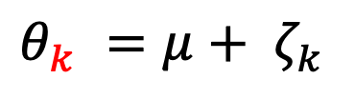
How to pool effect-sizes?
Fixed-effect model:
all effect sizes stem from a single population
-> all studies share the same true effect size
Random-effect model:
There is a distribution of true effect-sizes
$\hat{θ_{k}}=θ+ ε_{k}$
$\hat{θ_{k}}=θ_{k}+ ε_{k}$
$θ_{k} =μ+ ζ_{k}$

Slide 23
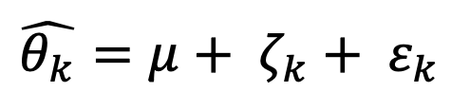
How to pool effect-sizes?
Fixed-effect model:
all effect sizes stem from a single population
-> all studies share the same true effect size
Random-effect model:
There is a distribution of true effect-sizes
$\hat{θ_{k}}=θ+ ε_{k}$
$\hat{θ_{k}}=θ_{k}+ ε_{k}$
$θ_{k} =μ+ ζ_{k}$
$\hat{θ_{k}}=μ+ ζ_{k}+ ε_{k}$

Slide 24
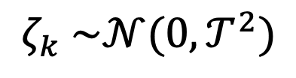
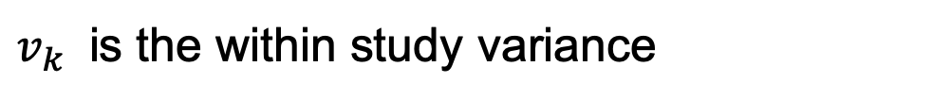
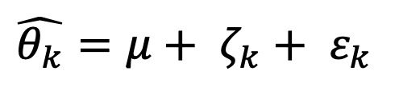
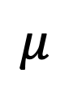
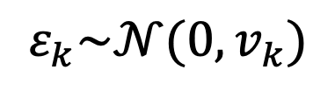
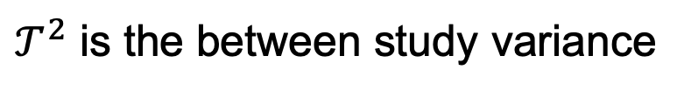
How to pool effect-sizes?
Random-effect model:
$\hat{θ_{k}}=μ+ ζ_{k}+ ε_{k}$
$$μ$$
is the overall mean (or meta-analytic mean)
$$ζ_{k} \sim 𝒩(0, 𝒯^{2})$$
$𝒯^{2}$ is the between study variance
$$ε_{k}\sim 𝒩(0,v_{k})$$
$v_{k}$ is the within study variance

Slide 25
How to pool effect-sizes?
Mixed-effect model:
« The perfect world »
Sampling variance
Effect-size

Slide 26
How to pool effect-sizes?
Mixed-effect model:
« The perfect world »
Sampling variance
Effect-size

Slide 27
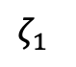
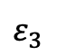
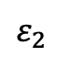
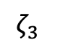
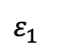
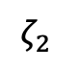
How to pool effect-sizes?
Mixed-effect model:
« The perfect world »
« The experimental world »
$$ζ_{1}$$
$ε_{1}$
$$ζ_{2}$$
$ε_{2}$
Sampling variance
$$ζ_{3}$$
$ε_{3}$
Effect-size

Slide 28





How to pool effect-sizes?
Fixed-effect model:
Mixed-effect model:
« The experimental world »
« The experimental world »
$ε_{1}$
$$ζ_{1}$$
$ε_{2}$
$ε_{1}$
$ε_{3}$
$$ζ_{2}$$
$ε_{2}$
$ε_{4}$
$$ζ_{3}$$
$ε_{5}$
$ε_{3}$

Slide 29

How to pool effect-sizes?
Mixed-effect model:
Weights $𝓌_{k}$
The usual statistical method for combining results of multiple studies is to weight studies by the amount of information they contribute
$$𝓌_{k}= \frac{1}{s_{k}^{2}+𝒯^{2}}$$

Slide 30

How to pool effect-sizes?
Mixed-effect model:
Methods to estimates $𝒯^{2}$
DerSimonian-Laird (DL) (default estimator in Revman, omprehensive Meta-Analysis, meta package)
Restricted Maximum Likelihood (REML) (default estimator in metafor package)
Paule-Mandel (PM)
…

Slide 31
How to pool effect-sizes?
Mixed-effect model:
Methods to better consider the distribution estimates $𝒯^{2}$
(a correction applicable after each of the previous mentionned estimators of $𝒯^{2}$)
- Knapp-Hartung Adjustments

Slide 32
How to pool effect-sizes?
Three levels meta-analysis :
Statistical independence of the effect sizes is one of the core assumptions when we pool effect sizes in a meta-analysis
BUT:
-One author could report several effect-sizes (multiples experiments, control, …)
-An overall structure of the data (Climate effect, country effect, ….)
→ Nested Three levels met-analyses

Slide 33







How to pool effect-sizes?
Random-effect model (2 levels):
There is a distribution of true effect-sizes
Random-effect model (3 levels):
There is a distribution of true effect-sizes
$\hat{θ_{k}}=θ_{k}+ ε_{k}$
$\hat{θ_{jk}}=θ_{jk}+ ε_{jk}$
$θ_{k} =μ+ ζ_{k}$
$θ_{jk} =κ_{j}+ ζ_{(2)jk}$
$\hat{θ_{k}}=μ+ ζ_{k}+ ε_{k}$
$κ_{j} =μ + ζ_{(3)j}$
$\hat{θ_{k}}=μ+ ζ_{(2)jk}+ζ_{(3)j}{+ ε}_{jk}$

Slide 34







How to pool effect-sizes?
Random-effect model (three levels):
$\hat{θ_{k}}=μ+ ζ_{(2)jk}+ζ_{(3)j}{+ ε}_{jk}$
$$μ$$
is the overall mean (or meta-analytic mean)
$$ζ_{(2)kj} \sim 𝒩(0, 𝒯_{(2)}^{2})$$
$𝒯_{(2)}^{2}$is the within cluster variability
$$ζ_{(3)j} \sim 𝒩(0, 𝒯_{(3)}^{2})$$
$𝒯_{(3)}^{2}$is the between cluster variability
$$ε_{kj}\sim 𝒩\left(0,v_{jk}\right)$$
$v_{jk}$ is the within study in cluster variance

Slide 35








How to pool effect-sizes?
Mixed-effect model (3 levels):
Mixed-effect model (3 levels):
« The experimental world »
« The experimental world »
$$ζ_{1}$$
$ε_{1}$
Same cluster
$$ζ_{2}$$
$$ε_{11 }$$
$$ε_{12 }$$
$ε_{2}$
$$ζ_{3}$$
$ε_{3}$

Slide 36


How to pool effect-sizes?
Mixed-effect model (3 levels):
Mixed-effect model (3 levels):
« The experimental world »
« The experimental world »
$$ζ_{1}$$
$ε_{1}$
Same cluster
$$ζ_{2}$$
$$ε_{11 }$$
$$ε_{12 }$$
$ε_{2}$
$$ζ_{(2)12}$$
$$ζ_{(2)11}$$
$$ζ_{3}$$
$ε_{3}$

Slide 37

How to pool effect-sizes?
Mixed-effect model (3 levels):
Mixed-effect model (3 levels):
« The experimental world »
« The experimental world »
$$ζ_{1}$$
$ε_{1}$
Same cluster
$$ζ_{2}$$
$$ε_{11 }$$
$$ε_{12 }$$
$ε_{2}$
$$ζ_{(2)12}$$
$$ζ_{(2)11}$$
$$ζ_{3}$$
$$ζ_{(3)1}$$
$ε_{3}$

Slide 38
How to pool effect-sizes?
Sub-group analyses
We assume that the different effect-sizes fall into different subgroups and that each subgroup has its own true overall effect
Possible to analyse subgroups in fixed- and random-effect models

Slide 39
How to pool effect-sizes?
Sub-group analyses
Why don’t we run a separate meta-anaysis for each group?
Estimates of the various varainces (i.e. $𝒯^{2}$, ..) will also differ from subgroup to subgroup, but could be very imprecise (when n is low)
Rather : We consider a common estimate of the between-study heterogeneity for each subgroups (better estimated).

Slide 40
How to pool effect-sizes?
Sub-group analyses
Assess if there is a true difference between the groups
Perform a statistical hypothesis test (compare the variance between vs. Within the groups)
In meta-analyses-> Cochran’s Q test (available by default).
Interpretation : at least one subgroup is part of a different population of studies (or not)

Slide 41
How to pool effect-sizes?
Meta-regressions:
Subgroup analyses are a special form of meta-regression
Use the value of some variable x to predict the value of another variable y, and applied to entire studies

Slide 42



How to pool effect-sizes?
Meta-regressions (mixed effect models):
$\hat{θ_{k}}=μ+ {βx}_{k}+ζ_{k}+ ε_{k}$
$β$ the regression coefficient
Estimated through weighted least squares (WLS)

Slide 43


Analysis of heterogeneity
Remember, heterogenity impact weights (of random effect meta-analyses)

Slide 44
Analysis of heterogeneity
Remember, it impacts the estimated variances, thus the confidence intervals, and p-value of the mean effect.
Summary effect
Summary effect

Slide 45


Analysis of heterogeneity
Cochran’s Q: which is calculated as the weighted sum of squared differences between individual study effects and the pooled effect across studies,
The I² statistic describes the percentage of variation across studies that is due to heterogeneity rather than chance
$𝒯^{2}$ is the between study variance

Slide 46

Analysis of heterogeneity
How to interpret I2?

